Slide 1
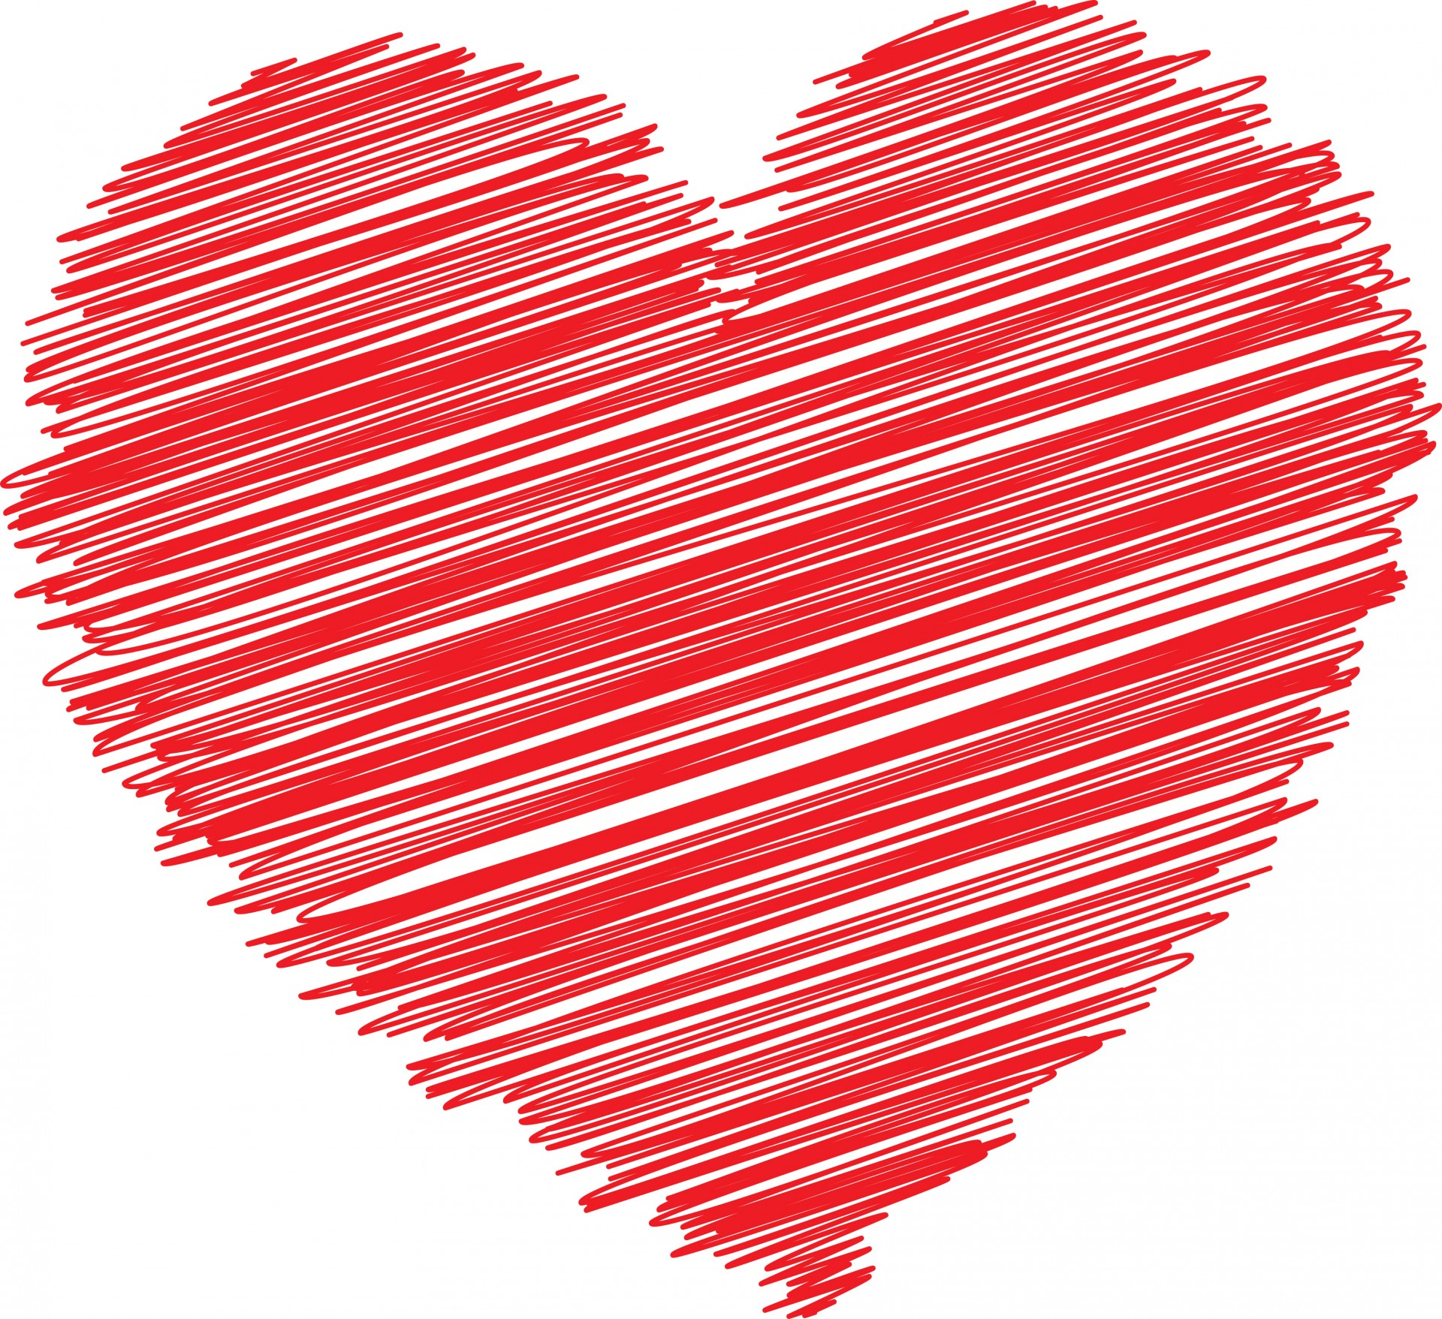
Chapter 5
Romantic Love and Positive Families

Slide 2
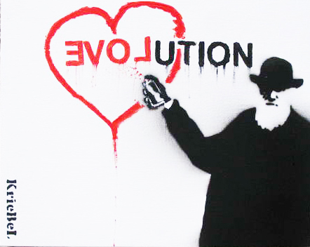
Genes, Hormones, and Marriage
Evolution and Love
Love has adaptive properties
Compelling experience of romantic love cannot be fully understood by knowing only about genes, hormones, and neurotransmitters

Slide 3
Genes, Hormones, and Marriage
The Biochemistry of Love
Oxytocin--hormone that increases in response to affection and love
Linked with social bonding (e.g., breastfeeding), generosity, feelings of closeness and intimacy
Oxytocin related to reductions in stress and anxiety
Related to increased motivation to seek out social contact and support
Endogenous opioids
Involved with social affiliation and can help diminish the impact of stress
Notes:
Endogenous opioids: Are also involved with social affiliation and can help diminish the impact of stress.

Slide 4
Genes, Hormones, and Marriage
Marriage and Subjective Well-Being
Married people happier and more satisfied in life than single people
Quality of marriage is also a significant predictor of subjective well-being
Positive interactions, more emotional expressiveness, greater role sharing
Empathy and gratitude
The effect of marriage on well-being is stronger for men

Slide 5
Genes, Hormones, and Marriage
Marriage and Subjective Well-Being
Same-sex, Opposite-sex
Same factors predict successful relationships/marriages
Mutual trust
Good communication
Healthy conflict management
One difference
Same sex may suffer more stress if family/relatives are not supportive

Slide 6
The Varieties of Love
Explicit theories analyze love in terms of its core elements or dimensions
Many of these theories see love as unidimensional
As a unidimensional concept, love encompasses attitudes, behaviors, feelings, and motivations
Most theories view it as multidimensional
Notes:
Michael Barnes and Robert Sternberg (1997) grouped perspectives on love into explicit and implicit theories.

Slide 7
The Varieties of Love
A Two-Factor Theory of Love
Fundamental and primary elements:
Passionate love
Companionate love
Notes:
Passionate love: An intense longing for one’s beloved, which can be experienced in a joyful emotional union and sexual fulfillment--or in the terrible despair of rejection.
Companionate love: A quieter form of love associated with affection, companionship, friendship, and long-term commitment to relationships.

Slide 8
The Varieties of Love
Passionate love
The intense arousal that fuels a romantic union
A state of intense longing for union with another
It is a complex functional whole including appraisals or appreciations, subjective feelings, expressions, patterned physiological processes, action tendencies, and instrumental behaviors.
Tend to fall passionately in love with people who are relatively good looking, personable, affectionate and similar to ourselves.
Generally very fleeting
Notes:
Passionate love: An intense longing for one’s beloved, which can be experienced in a joyful emotional union and sexual fulfillment--or in the terrible despair of rejection.
Companionate love: A quieter form of love associated with affection, companionship, friendship, and long-term commitment to relationships.

Slide 9
The Varieties of Love
Companionate love
The soothing, steady warmth that sustains a relationship
Involves feelings of mutual respect, trust and affection, while passionate love involves intense feelings and sexual attraction.
Manifested in a strong bond and intertwining of lives that brings about feelings of comfort and peace
Notes:
Passionate love: An intense longing for one’s beloved, which can be experienced in a joyful emotional union and sexual fulfillment--or in the terrible despair of rejection.
Companionate love: A quieter form of love associated with affection, companionship, friendship, and long-term commitment to relationships.

Slide 10
The Varieties of Love
The Love Styles: Six styles of love
Eros (passionate)
Storge (companionate)
Ludus (“game-playing” love…emotional manipulation)
Pragma (seek partner with certain conditions, e.g., wealth, physically attractive)
Mania (periods of wonderful highs and awful lows)
Agape (selfless love)
Notes:
Six styles of love:
Eros, storage, ludus, pragma, mania, agape.
People who scored high on the eros style tended to be paired with partners who also scored high on it.
Ludus style, in women, significantly decreased satisfaction for their male partners.
Mania style in men decreased satisfaction for their female partners.

Slide 11
The Varieties of Love
The Love Styles
Henrick study on dating couples
Happy couples showed similar love styles
Higher scores on eros—higher relationship satisfaction
Male are more satisfied with the relationship when women are passionate and altruistic
Notes:
Six styles of love:
Eros, storage, ludus, pragma, mania, agape.
People who scored high on the eros style tended to be paired with partners who also scored high on it.
Ludus style, in women, significantly decreased satisfaction for their male partners.
Mania style in men decreased satisfaction for their female partners.

Slide 12
The Varieties of Love
Sternberg’s Love Triangle
Experiences of love based on three components:
Passion: intense emotional response
Intimacy or liking: warmth, closeness
Commitment: decision to maintain relationship
Notes:
Passion: An intense emotional responses to the other person.
Intimacy or liking: Warmth, closeness, and sharing of self in a relationship.
Commitment: The decision to maintain the relationship.
Combination of two types of love:
Romantic love (intimacy + passion)
Companionate love (intimacy + commitment)
Fatuous love (passion + commitment)
Consummate love (all three)

Slide 13
The Varieties of Love
Sternberg’s Love Triangle
Combination of two types of love:
Romantic love (intimacy + passion)
Companionate love (intimacy + commitment)
Fatuous love (passion + commitment)
Consummate love (all three)
Notes:
Passion: An intense emotional responses to the other person.
Intimacy or liking: Warmth, closeness, and sharing of self in a relationship.
Commitment: The decision to maintain the relationship.
Combination of two types of love:
Romantic love (intimacy + passion)
Companionate love (intimacy + commitment)
Fatuous love (passion + commitment)
Consummate love (all three)

Slide 14
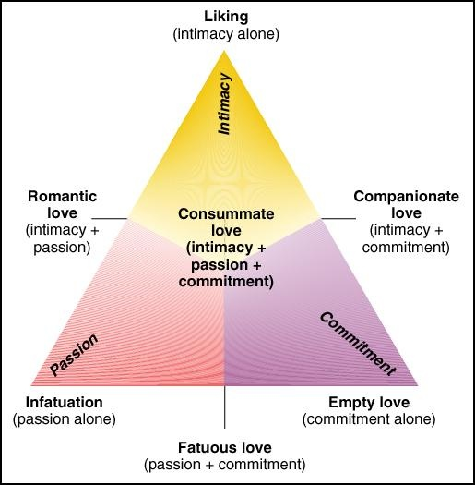

Slide 15
The Varieties of Love
Love as a Prototype or an Ideal
Implicit theories of love
View love as extremely personal experience
Involve comparing our current feelings with a cultural standard or ideal
Core aspects of our prototypes of love seem to be intimacy, passion, and commitment
Notes:
Implicit theories of love: View it as an extremely personal experience in which people define their own ideas of love in relation to a culturally ideal standard. In implicit theories of love, the match between one’s real lover and one’s “ideal” lover is primary.

Slide 16
The Varieties of Love
The Love Hierarchy
Three levels of hierarchically arranged meanings that people used to describe love:
Qualities people valued in their relationships: Trust, sincerity, mutual understanding, compatibility, fulfillment, sexuality, intimacy, and mutual needs (lowest level)
Compatibility and passion
Love (highest level)
Notes:
Qualities people valued in their relationships:.
Compatibility and passion:
Compatibility factor as the “warm” factor that allows for commitment over time and feelings of companionship, friendship, and respect.
Passion factor is the “hot” factor that defines feelings of desire, romance, and sexual need (i.e., passionate love).

Slide 17
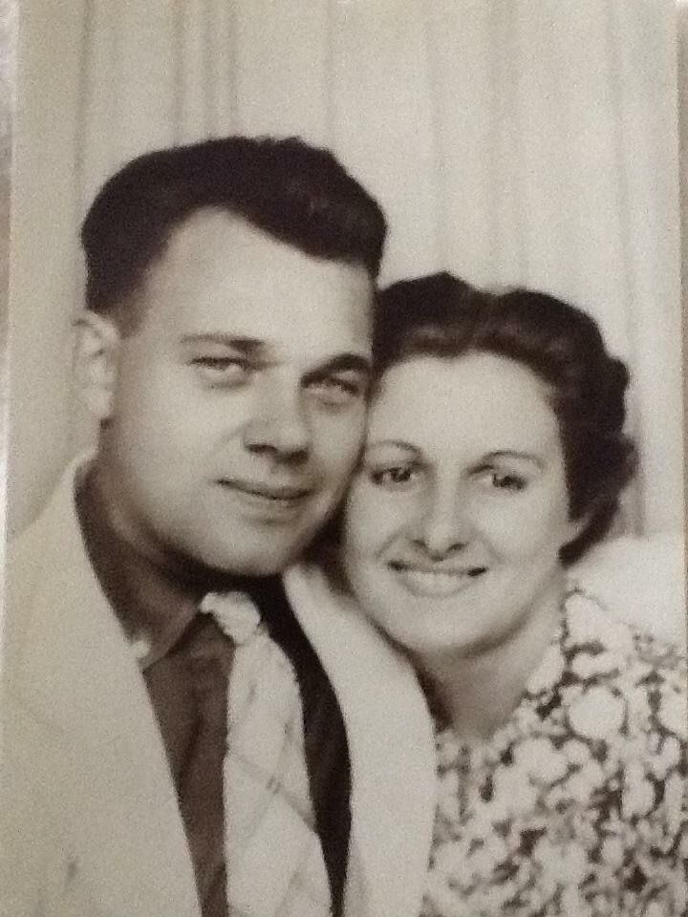
Finding Romance and Love
What Attracts Us to Someone?
Proximity, physical attractiveness, attitude similarity, and reciprocity
Physical allure
The color red
Ideals of attractiveness differ among cultures
Similarity of attitudes and values (homogamy)-high similarity with happily married couples

Slide 18
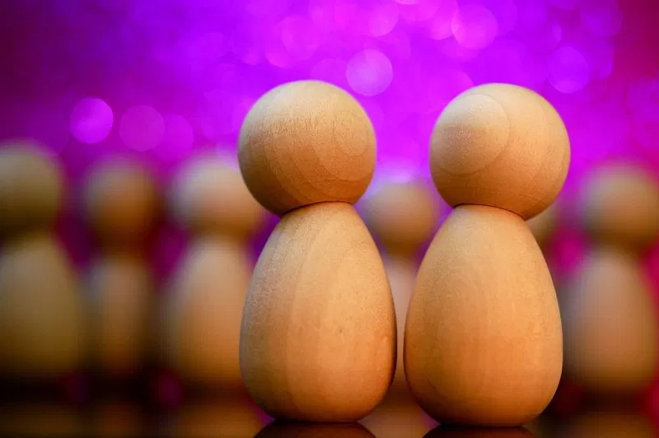
Relationship Satisfaction: What Makes Them Feel Good
“Satisfaction” is not an end state…it is a dynamic process that changes over time in response to situations, stresses, and the personal growth of each person

Slide 19
Relationship Satisfaction: What Makes Them Feel Good
Personality Traits
Surveys asked for highest ranked quality: tend to list healthy personality traits (e.g., confident, gentle, integrity, warm, ability to love)
Most frequent predictor of poor relationships was neuroticism
Chronic neuroticism often leads to chronic focus on self

Slide 20
Relationship Satisfaction: What Makes Them Feel Good
Personality Traits…Note
Traits are broad summaries of behaviors over time…not getting at psychological processes in relationship satisfaction
Love involves more than personality traits

Slide 21
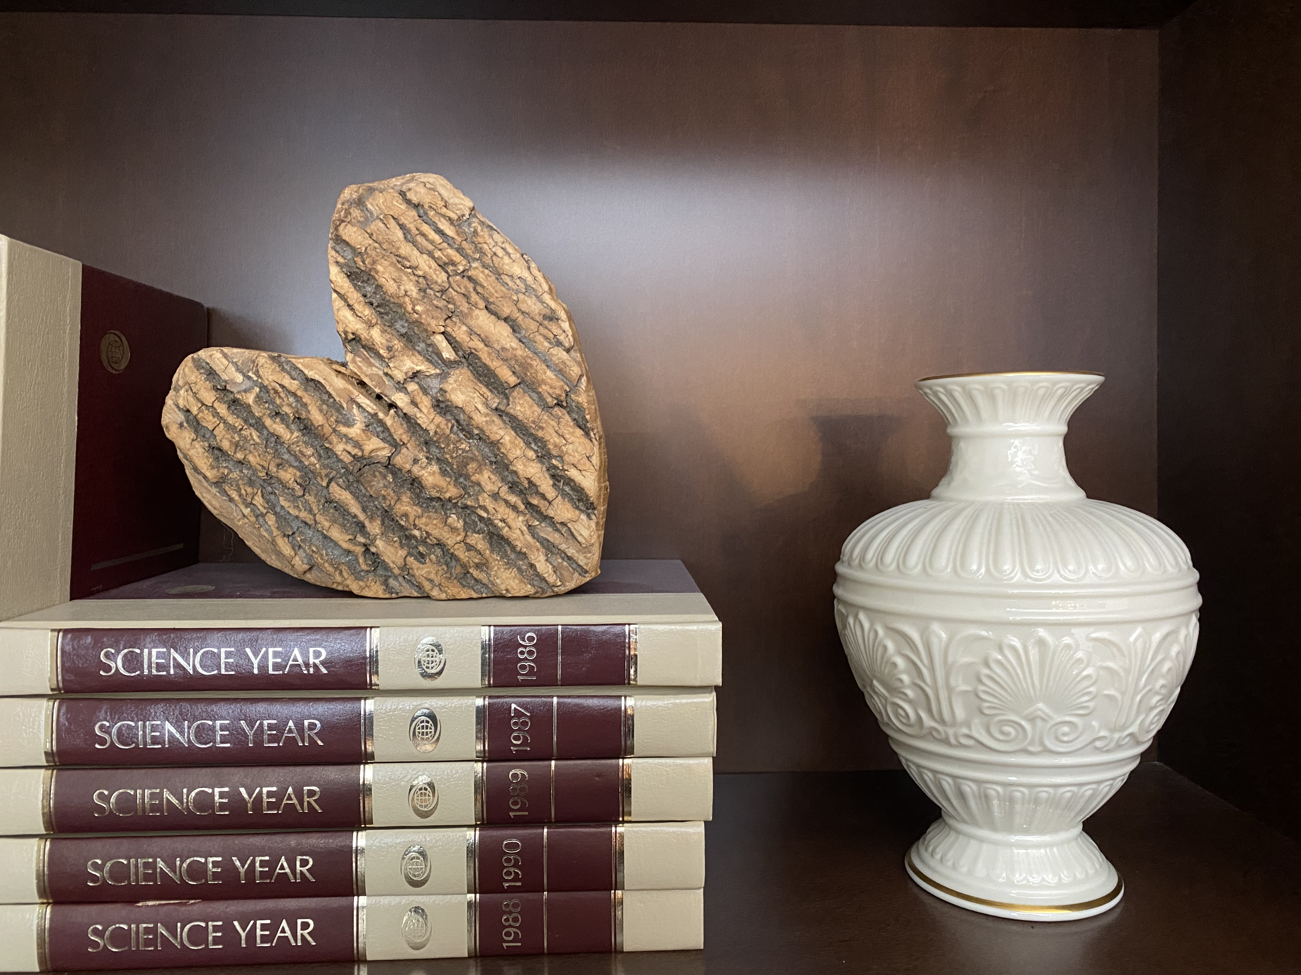
Relationship Satisfaction: What Makes Them Feel Good
Communication
Most couples want more time and better conversations, not more sex
Bids for attention
Gestures that indicate affection, attention, humor or support
The topics couples discuss together may be important to well-being of a relationship
Meaningful conversations help foster increased relationship satisfaction and happiness

Slide 22
Relationship Satisfaction: What Makes Them Feel Good
Satisfied Couples
Dissatisfied Couples
More mutually supportive
Laugh together more
Withhold comments that may be received negatively
Agree more about a variety of topics
Exhibit communication characterized by greater disagreement
Less humor and laughter
More expression of negative emotions like anger or disgust
Fewer helpful comments
More criticism

Slide 23
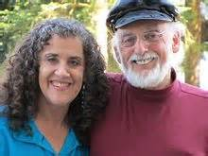
Relationship Satisfaction: What Makes Them Feel Good
John and Julie Gottman
Longitudinal studies of married couples
Magic ratio for marriages: 5:1
5 positive interactions to one negative needed to maintain a healthy relationship
As ratio approaches 1:1, divorce is likely
5:1 does not mean no arguments…talk about difficult situations with positive interactions of warmth, affection, and humor
The Gottman Institute

Slide 24
Relationship Satisfaction: What Makes Them Feel Good
Communication: Capitalization
Capitalization…an example of social support
Helpful to the person sharing, the person listening, or both
Means revealing positive things about oneself or one’s experiences

Slide 25
Relationship Satisfaction: What Makes Them Feel Good
Communication: Capitalization
Capitalization…an example of social support
Spouse smiling home from work and says “I was just offered a big promotion at work”
Passive-destructive “did you get dinner?”
Active-destructive “I’ll see less of you”
Passive-constructive “Nice.”
Active-constructive** “That’s great. I’m proud of you. You will be great at it”

Slide 26
Relationship Satisfaction: What Makes Them Feel Good
Communication: Self-Disclosure
Self-disclosure: Revealing to oneself and others exactly who, what, and where one is
Transparency: live more zestfully because not wasting time/energy disguising true feelings or thoughts
Involves self-awareness
Value to intimate relationships, not the person you meet on the street
Caution: self-disclosure in the workplace

Slide 27
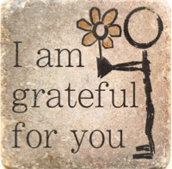
Relationship Satisfaction: What Makes Them Feel Good
Communication: Gratitude, Empathy, and Curiosity
Gratitude: Helps to maintain and enhance social relationships
Frequent and small better than big and rare

Slide 28
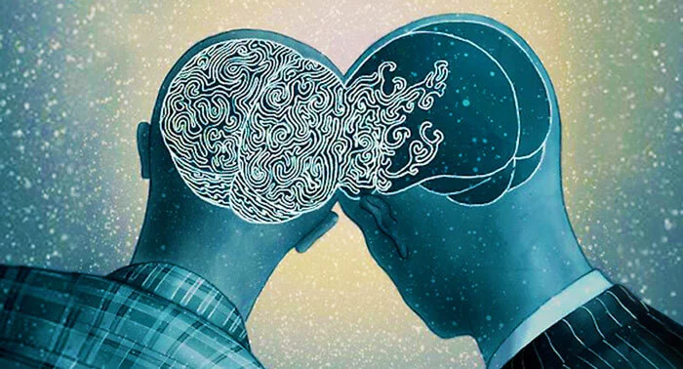
Relationship Satisfaction: What Makes Them Feel Good
Communication: Gratitude, Empathy, and Curiosity
Empathy: Social glue to maintain the relationship
Affective: emotional engagement with other’s situation
Cognitive: intellectual awareness of other’s situation

Slide 29
Relationship Stability: What Makes It Last?
High satisfaction with a relationship does not necessarily translate into long-term stability
All terminal marriages are not failures
Low quality marriages affect spouse and children

Slide 30
Relationship Stability: What Makes It Last?
Surveyed 300 married 15+yrs (ave length 1st marriage is 8yrs; median 11yrs)
Qualities most important to successful marriage:
My spouse is my best friend
I like my spouse as a person
I believe that marriage is a LT commitment
We agree on aims and goals
My spouse has grown more interesting over the years
I want the relationship to succeed
Marriage is a sacred institution

Slide 31
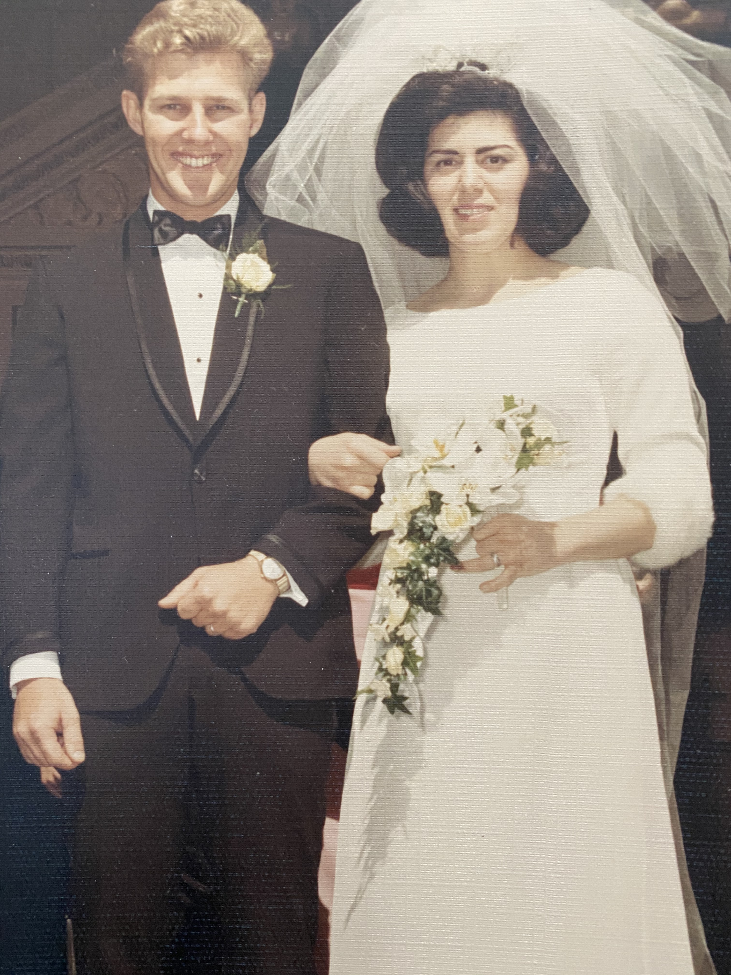
Relationship Stability: What Makes It Last?
Research on Stability?
Friendship is essential
Specific ways couples interact…genuine interest, communication, affection
Culture of appreciation
Gottman: take 5min/daily express sincere appreciation
Traits of self-confidence and nurturance

Slide 32
Minding Relationships
Minding: “reciprocal knowing process involving the nonstop, interrelated thoughts, feelings, & behaviors of persons in a relationship”
A way of paying close attention to relationships
Notes:
Minding comprises file components that help enhance closeness, intimacy, caring, and commitment:
Knowing and being known
Attribution
Acceptance and respect
Reciprocity
Continuity

Slide 33
Minding Relationships
Five components help enhance closeness, intimacy, caring, and commitment
Knowing and being known
Attribution
Acceptance and respect
Reciprocity
Continuity
Notes:
Minding comprises file components that help enhance closeness, intimacy, caring, and commitment:
Knowing and being known
Attribution
Acceptance and respect
Reciprocity
Continuity

Slide 34
Minding Relationships
Knowing and Being Known aka“love maps”
A desire to know and understand your partner (preferences, habits, memories of important events)
Dispositional authenticity
Ability to be open, honest with self and in congruence with deepest beliefs
Trait mindfulness
Greater awareness of one’s partner
Helps increase emotional regulation

Slide 35
Minding Relationships
Attributions
Judgment of the causes of partner’s behavior
Fundamental attribution error
Satisfied couples…dispositional and stable attributions for positive behavior, situational, temporary for negative behavior
Use of optimistic or pessimistic explanatory styles

Slide 36
Minding Relationships
Attributions: Positive Romantic Illusions: Is Love Really Blind?
Positive romantic illusions are vital for relationship success
The Michelangelo phenomenon
Close relationship partners are often active participants in each other’s personal development and goal pursuit…not going well, hinder personal development of the other
Notes:
The psychological state of “being-love”: Entails seeing one’s romantic partner as not only wonderful and extraordinary but also as essentially perfect.
The Michelangelo phenomenon: Close relationship partners are often active participants in each other’s personal development and goal pursuit.

Slide 37
Minding Relationships
Acceptance and Respect
Realistic acknowledgment of one’s partner with honesty
Healthy relationships are balance between independence and dependence
Gratitude
Empathic accuracy and forgiveness
Self-compassionate couples displayed more positive relationship behavior

Slide 38
Minding Relationships
Acceptance and Respect
Self-expansion model
Motivation to expand concept of self by incorporating qualities of those one feels close to

Slide 39
Minding Relationships
Reciprocity
Fair balance of benefits from being together
Two theories have dominated this aspect of marital satisfaction and stability:
Balance theory
Social exchange theory
Notes:
Balance theory: Assumes that it is not the presence of negative emotions or behaviors that is important for stability, but how they are regulated.
Social exchange theory: Assumes that relationships are an exchange of rewards and costs. These are often called bank account theories and consider satisfaction the result of a cost-benefit analysis that evaluates the ratio of positive interactions to negative interactions.

Slide 40
Minding Relationships
Reciprocity: Balance Theory
How negative emotions are regulated is important for stability (not absence of them)
Regulated couples: balanced and predictable
Validating couples: stable and free from undue conflict
Non-regulated couples
More negative emotionality, more sever problems, less positive affect, lower satisfaction, greater likelihood of ending

Slide 41
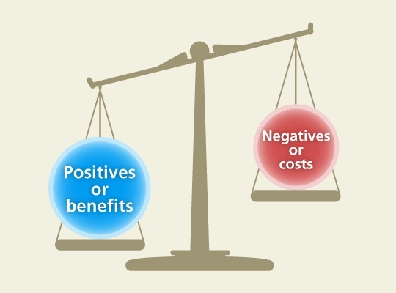
Minding Relationships
Reciprocity: Social exchange theory
Relationships are an exchange of rewards and costs
Cost-benefit analysis: ratio of positive to negative interactions

Slide 42
Minding Relationships
Continuity
Continuity requires adaptability, flexibility, and an ongoing desire to recommit to minding, despite external stresses or an overfamiliarity that can lead to boredom

Slide 43
Minding Relationships
Continuity: Relationships as a Vehicle for Personal Growth
All relationships eventually experience some difficulties
Psychological challenges may lead to development of greater psychological maturity in themselves and in relationship

Slide 44
Minding Relationships
Continuity: Virtues and Marital Well-Being
Relationships need a strong commitment to virtues
Loyalty, courage, generosity, justice
Manage and overcome difficulties

Slide 45
Minding Relationships
Continuity: Cuddling, Sex, and Tenderness
Greater relationship satisfaction for men and women with sexual satisfaction
Sexual desire and activity remain well into 70s and 80s
Cuddling builds positivity in romantic partners and perceived as nurturant

Slide 46
Positive Families
Children have little impact on couple satisfaction
Parenthood may increase life satisfaction when couple is married, over 30, middle class and college educated
Family life cycle
Parenthood
Psychological boost from child-rearing

Slide 47
Positive Families
What Makes a Flourishing Family?
Adler believed every child strives for competency in the world and within family
Psychologically healthy family exhibits four vital characteristics
Warmth and respect among family
Democratic decision making (no authoritative)
Rules and practices that encourage emotional maturity and autonomy
Friendly and constructive relations within family and wider community
Notes:
Authoritative parenting style: Reasonable rules, high demands, high communication, high warmth and support.

Slide 48
Positive Families
What Makes a Flourishing Family?
Baumrind: Authoritative parenting style
Reasonable rules, high demands, high communication, high warmth and support.
Maintaining continuity in positive caregiving
Maintaining high but reasonable emotional engagement with their children
Notes:
Authoritative parenting style: Reasonable rules, high demands, high communication, high warmth and support.

Slide 49
Positive Families
The Family Life Cycle
Marital satisfaction decreases after the arrival of children, satisfaction with parenting roles and other elements of family live rises
Satisfaction is high during the initial years of marriage
Empty nest syndrome is a myth
Staying attuned to each other’s lives despite the added stress
Parenthood as a collaborative effort

Slide 50
What Hurts Relationships?
Conflict
Primary cause of marital dissolution
Communication problems are the chief reason given for getting divorced

Slide 51
What Hurts Relationships?
The Demand-Withdraw Pattern and Stonewalling
Four-step pattern particularly destructive to relationships
Stonewalling: A passive-aggressive attempt to punish the other person
Demand-withdrawal pattern of marital communication
Notes:
Four-step pattern particularly destructive to relationships:
Criticism and complaining
A sense of contempt
Defensiveness
Withdrawal

Slide 52
Gottman’s Multidimensional Therapy Approach
Relationship
Undermining Behaviors
Replace With Relationship Enhancing Behaviors
Criticism
Contempt
Defensiveness
Stonewalling
Complaint
Appreciation
Responsibility
Self-soothing
Notes:
The relationship undermining behaviors are definitely listed in the chapter, however the relationship enhancing behaviors are not. Question of whether or not they should be left in, or whether this slide should be reformatted.

Slide 53
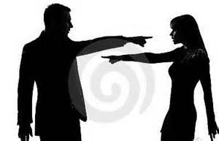
Gottman 4 Horsemen of Apocalypse
Criticism
Complaint vs. criticism
Complaining is normal and focuses on behavior
Criticism attacks the character of the person
Complaint: "You should have told me earlier that you're too tired to make love. I'm disappointed, and I feel embarrassed."
Criticism: "Why are you so selfish? It was really nasty of you to lead me on. You should have told me earlier that you were too tired to make love."

Slide 54
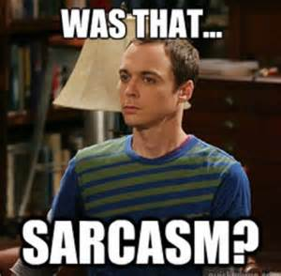
Gottman 4 Horsemen of Apocalypse
Contempt
Often follows criticism
Person uses "sarcasm, cynicism, name-calling, eye-rolling, sneering, mockery, and hostile humor
Worst of the 4 because it communicates disgust to the person it is directed toward, which escalates conflict

Slide 55
Gottman 4 Horsemen of Apocalypse
Defensiveness
When one partner uses contempt, the other typically becomes defensive
Stonewalling
One partner tunes out the other
More common in men than women

Slide 56
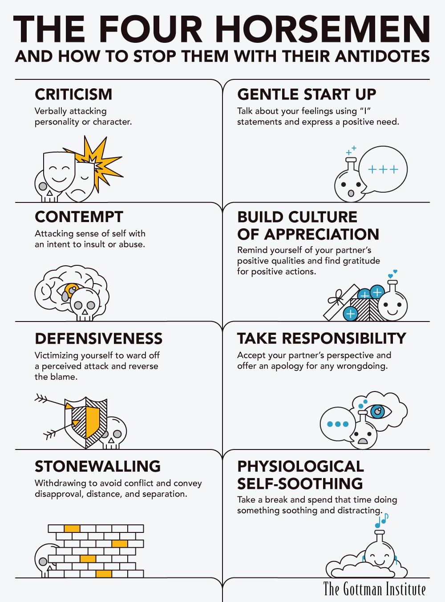

Slide 57
How to Nurture Positive Relationships That Last
The Seven Principles for Making Marriage Work (Gottman & Silver)
Enhance your love maps
Nurture your fondness and admiration
Turn toward each other instead of away
Let your partner influence you
Solve your solvable problems
Overcome gridlock and move toward dialogue
Create shared meaning
Notes:
The Seven Principles for Making Marriage Work
Enhance your love maps
Nurture your fondness and admiration
Turn toward each other instead of away
Let your partner influence you
Solve your solvable problems
Overcome gridlock and move toward dialogue
Create shared meaning

Slide 58
How to Nurture Positive Relationships That Last
Magic 5 hr per week
Work daily on building relationship
Focusing on the negatives almost never is productive…rather focus on what your partner is doing right
Notes:
The Seven Principles for Making Marriage Work
Enhance your love maps
Nurture your fondness and admiration
Turn toward each other instead of away
Let your partner influence you
Solve your solvable problems
Overcome gridlock and move toward dialogue
Create shared meaning

